Slide 1


.NET MAUI Part 1: Our First App
<Name>
<Role>
@<Twitter>
/<YouTube>

Slide 2
.NET MAUI: Part 1: Our First App
James Montemagno
Principal Lead PM – Developer Community, Microsoft
@JamesMontemagno
/JamesMontemagno

Slide 3
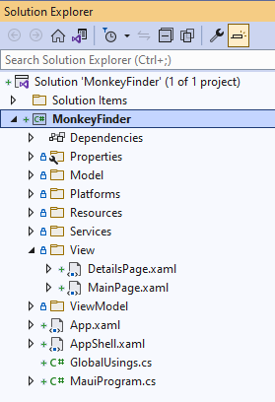
Project Structure
1 Single Project that hosts all of the source code for the project including UI, platform code, shared resources, and more

Slide 4
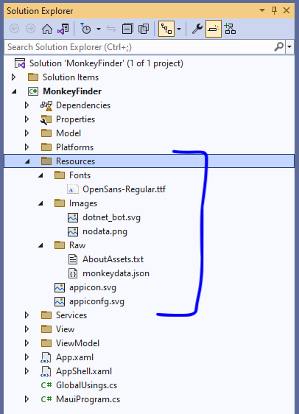
Cross-Platform Resources
Fonts, Images, Raw assets are all contained in the project.
Fonts – Automatically configured per platform
Images – Resized & SVG converted
App Icons & Splash Screens also supported

Slide 5
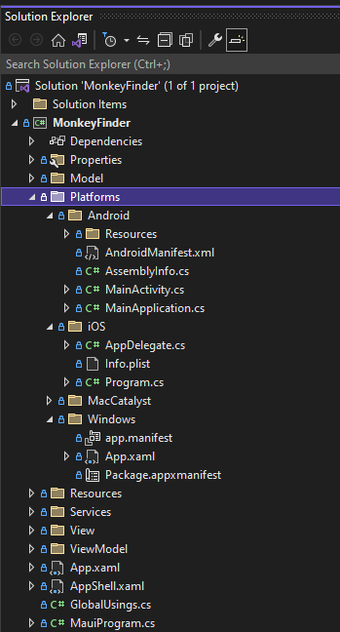
Platform Integration
Platform Specific folders hold platform specific resources, configuration, startup logic, and platform code.

Slide 6
Multi-Targeted
<TargetFrameworks>
net8.0-android;net8.0-ios;net8.0-maccatalyst;net8.0-windows10.0.19041
</TargetFrameworks>
<!-- Display name -->
<ApplicationTitle>MonkeyFinder</ApplicationTitle>
App Identifier -->
<ApplicationId>com.companyname.monkeyfinder</ApplicationId>
<!-- Versions -->
<ApplicationVersion>1</ApplicationVersion>

Slide 7
Conditionally Compile
#if ANDROID
var button = new Android.Widget.Button(context);
#elif IOS
var button = new UIKit.UIButton();
#endif

Slide 8
.NET MAUI Startup
public static MauiApp CreateMauiApp()
{
var builder = MauiApp.CreateBuilder();
builder
.UseMauiApp<App>()
.ConfigureFonts(fonts =>
{
fonts.AddFont("OpenSans-Regular.ttf", "OpenSansRegular");
});
return builder.Build();
}

Slide 9
.NET MAUI Startup
public static MauiApp CreateMauiApp()
{
var builder = MauiApp.CreateBuilder();
builder
.UseMauiApp<App>()
.ConfigureFonts(fonts =>
{
fonts.AddFont("OpenSans-Regular.ttf", "OpenSansRegular");
});
builder.Services.AddSingleton<MonkeyService>();
builder.Services.AddSingleton<MonkeysViewModel>();
builder.Services.AddSingleton<MainPage>(); return builder.Build();
}

Slide 10
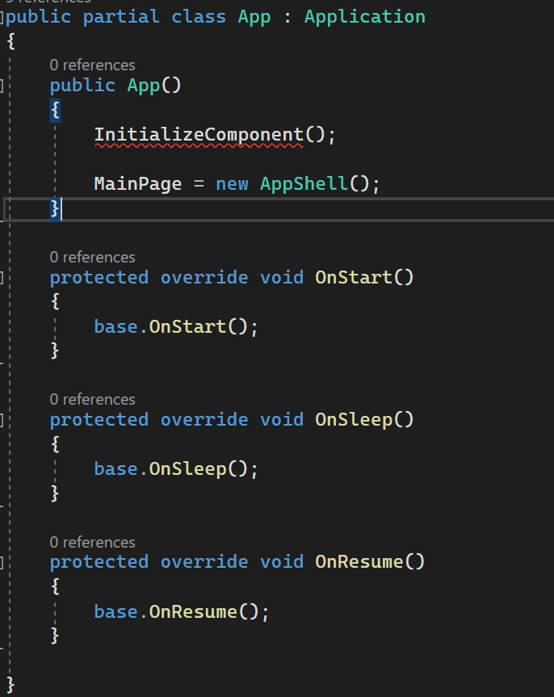

.NET MAUI Application
Application lifecycle:
OnStart
OnSleep
OnResume

Slide 11
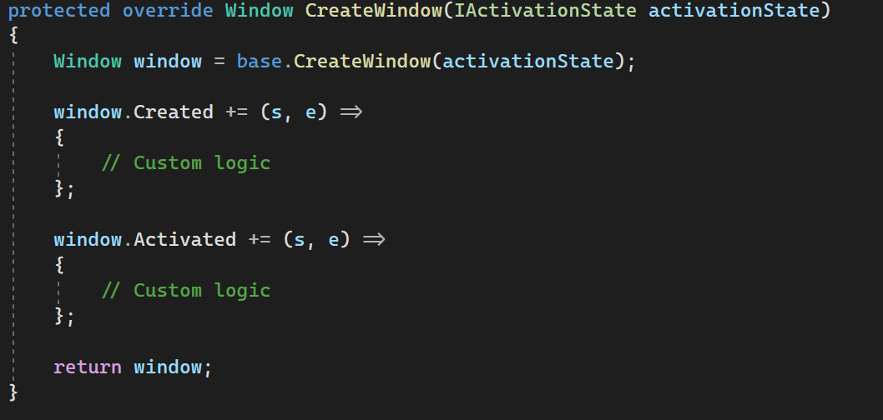
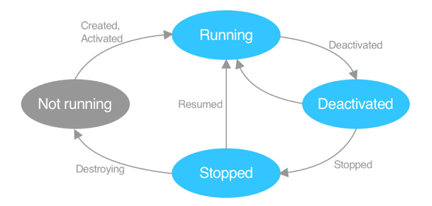
.NET MAUI Application Lifecycle
Windows lifecycle:
Created
Activated
Deactivated
Stopped
Resumed
Destroying

Slide 12
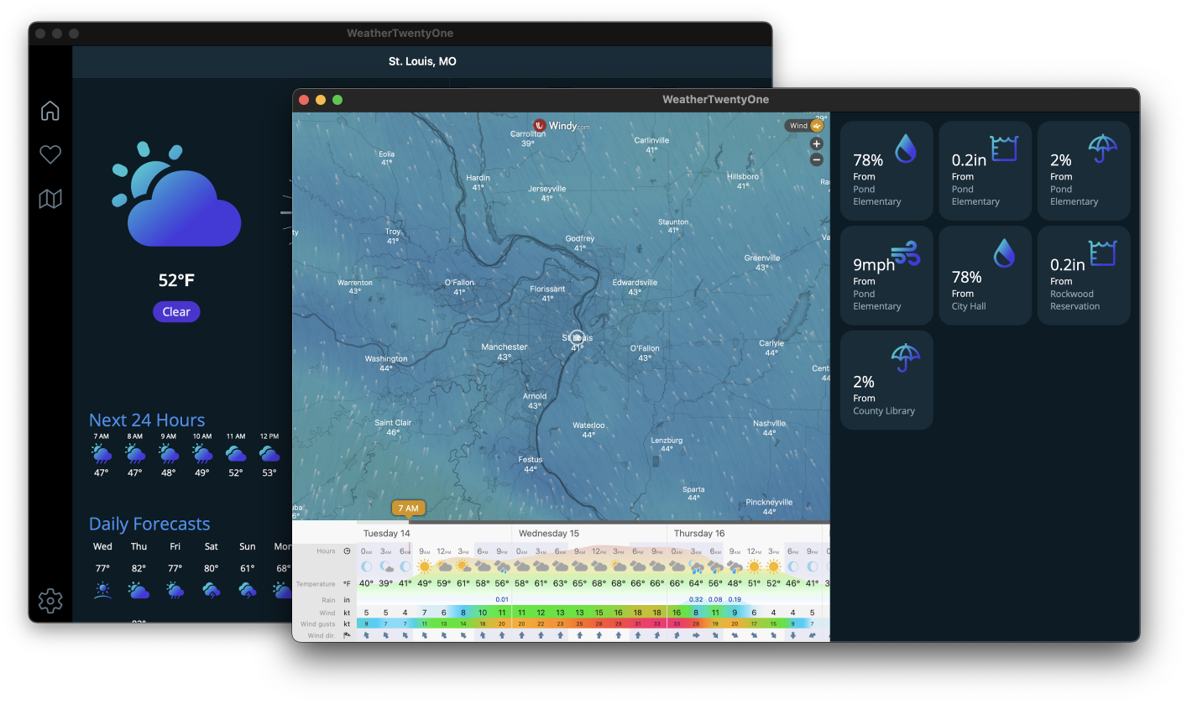
Multi-window
var secondWindow = new Window { Page = new MySecondPage { // ... } };
Application.Current.OpenWindow(secondWindow);

Slide 13
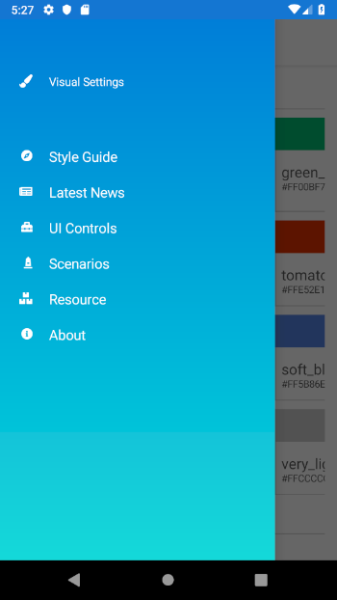
Shell
<Shell>
<FlyoutItem
Title="Style Guide"
Icon="Compass.png">
<ShellContent
ContentTemplate="{DataTemplate p:StyleGuidePage}"/>
</FlyoutItem>
</Shell>

Slide 14
Pages
Single screen of content
ContentPage holds one visual element
ContentPage
Content property
Control

Slide 15
Layout
Layouts handle child elements
Layouts include:
Grid
StackLayout
RelativeLayout
FlexLayout
& more
ContentPage
Content property
Layout
Layout
Children
Control
Control
Control
Control

Slide 16
Providing Behavior
Controls expose properties to alter visualization
var entry = new Entry { Placeholder = "Enter text", Keyboard = Keyboard.Email }; entry.TextChanged += (sender, e) => { // Input changed };
Controls expose events to provide interactive behavior

Slide 17
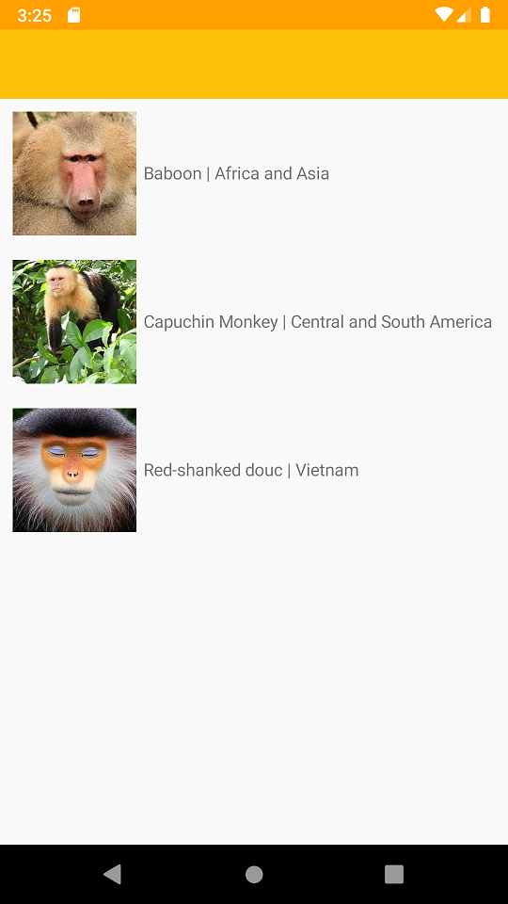
Let’s do it! Part 1 – Displaying Data
aka.ms/maui-workshop

Slide 18
20 Minute Break
<Name>
<Title>
<email>
<website>
@<twitter>
/<YouTube>

Slide 19
20 Minute Break
James
Montemagno
Principal Lead PM – Developer Community, Microsoft
motz@microsoft.com
montemagno.com
@JamesMontemagno
/JamesMontemagno

